Slide 1
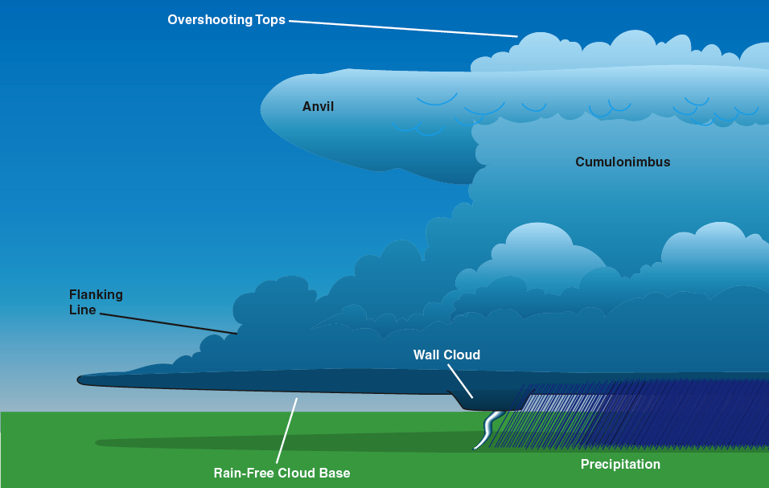
Soaring Weather

Slide 2
Basic Soaring Weather Info
General synoptic situation
Clouds and precipitation
Thermals
  Time of trigger height
  Height and strength vs. time of day
  When thermals end
Inversions
Visibility
Surface wind
Winds aloft
Adverse weather

Slide 3
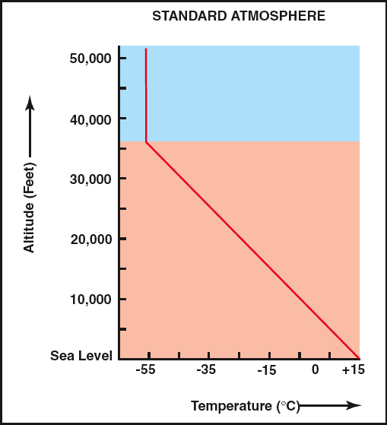
The Standard Atmosphere
Pressure Lapse Rate
  1” Hg / 1000’
Temperature Lapse Rate
  3.6 deg F / 1000’
  2.0 deg C / 1000’
Density Lapse Rate
  3% / 1000’

Slide 4
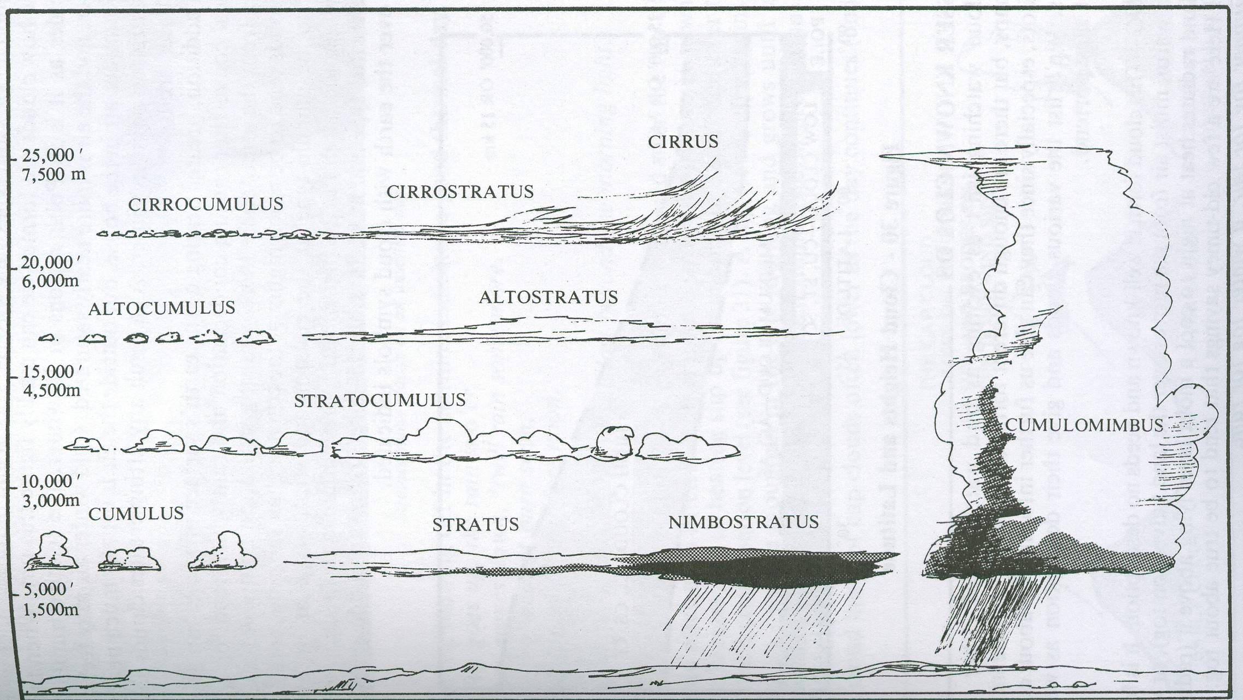
Cloud Types and Heights

Slide 5
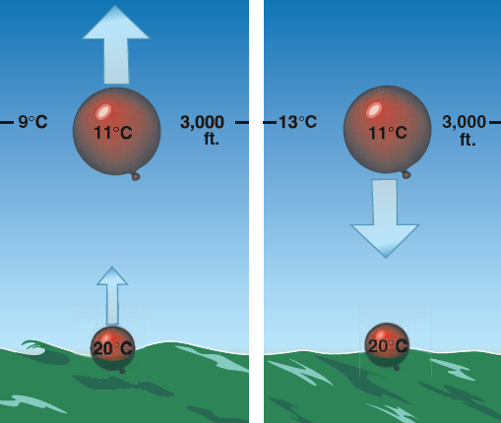
Stable & Unstable Air

Slide 6
Dry Adiabatic Lapse Rate (DALR)
The rate at which a rising parcel of dry (unsaturated) air cools adiabatically
  5.5 deg F per 1,000’

Slide 7
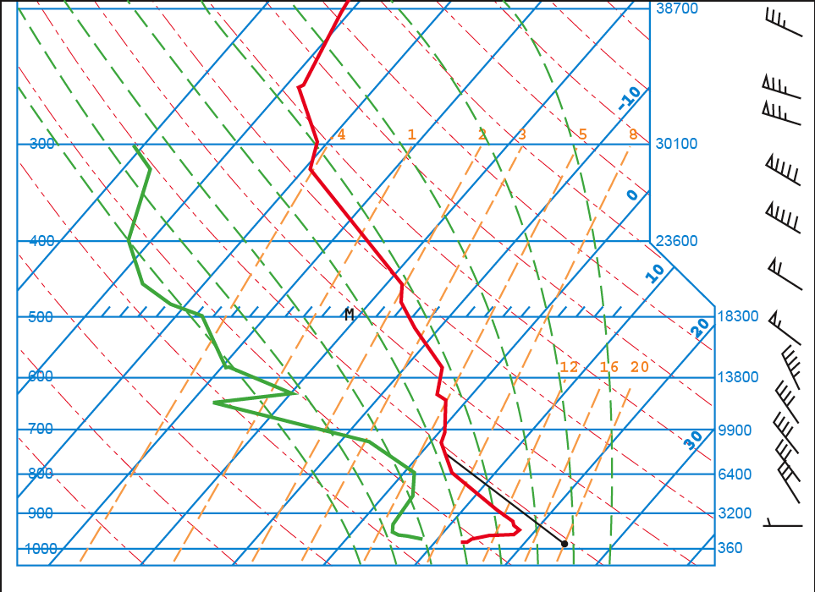
Skew T - Log P Diagram

Slide 8
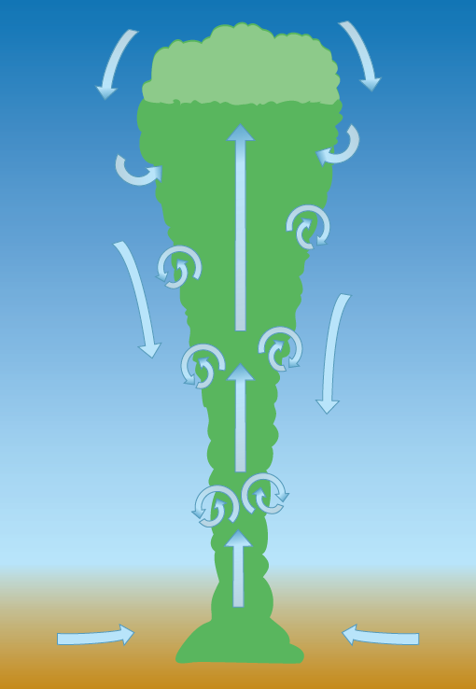


Thermal Models
Plume
Bubble
Cross-Section

Slide 9
Skew T - Log P Diagram
Constant Pressure Lines

Slide 10
Skew T - Log P Diagram
Constant Temperature Lines

Slide 11
Skew T - Log P Diagram
Dew Point Sounding
Temperature Sounding

Slide 12
Skew T - Log P Diagram
Dry Adiabatic Lapse Rate (DALR)

Slide 13
Skew T - Log P Diagram
Surface Temperature

Slide 14
Skew T - Log P Diagram
Height of
Convection
Surface Temperature

Slide 15
Skew T - Log P Diagram
Constant Mixing Ratio Lines

Slide 16
Skew T - Log P Diagram
Saturated Adiabatic Lapse Rate (SALR)

Slide 17
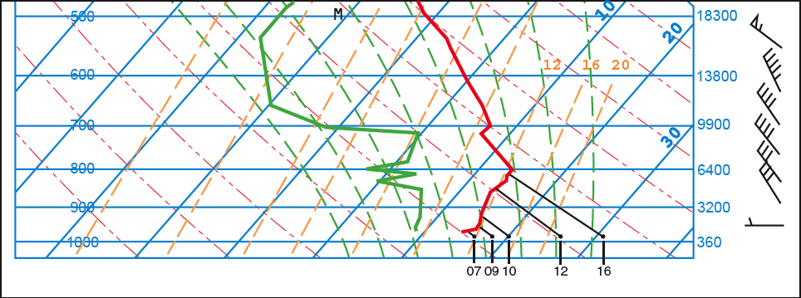
Thermal Height vs. Time of Day

Slide 18
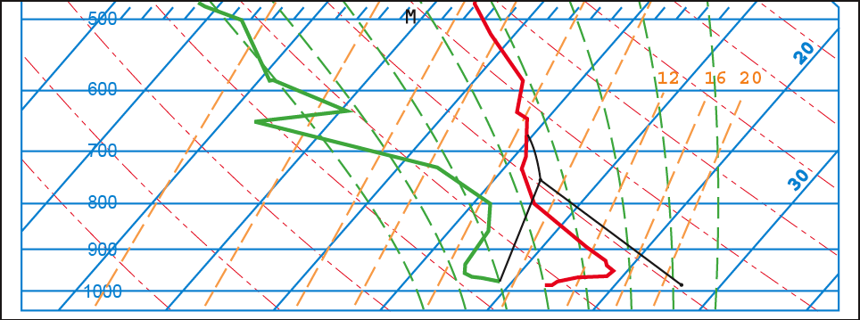
Cloudbase and Depth

Slide 19
Cloudbase and Depth
Cloud Top
Cloudbase

Slide 20
Thermal Index
A measure of atmospheric stability
  Negative is good (unstable – thermals)
  Positive is bad (stable – sled ride)
Computing the Thermal Index (TI)
  Determine the temperature of a lifted parcel of air at an altitude of interest
    From surface temperature and DALR
  Determine the ambient temperature at that altitude
    From a sounding
  Subtract the temperature of the lifted airmass from the measured temperature at that altitude

Slide 21
Predicting the Height of Cloudbase
Determine the altitude where the temperature of air in a rising parcel equals the dewpoint
Rate of temperature-dewpoint convergence
  4.4 deg F per 1,000 feet
Formula for computing cloudbase height
  [ (Surface temperature – Dewpoint )/ 4.4 ] x 1,000 feet
Is the computed cloudbase height < Intersection of max surface temp DALR intersection with sounding?
  Yes – Cumulus
  No – Nil cu

Slide 22
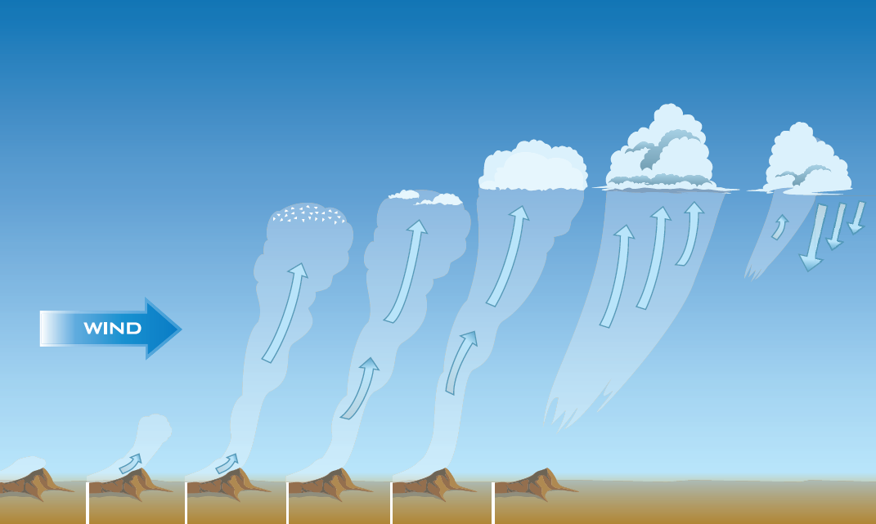
Thermal Life Cycle

Slide 23
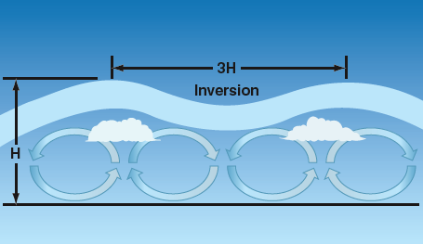
Cloudstreets

Slide 24
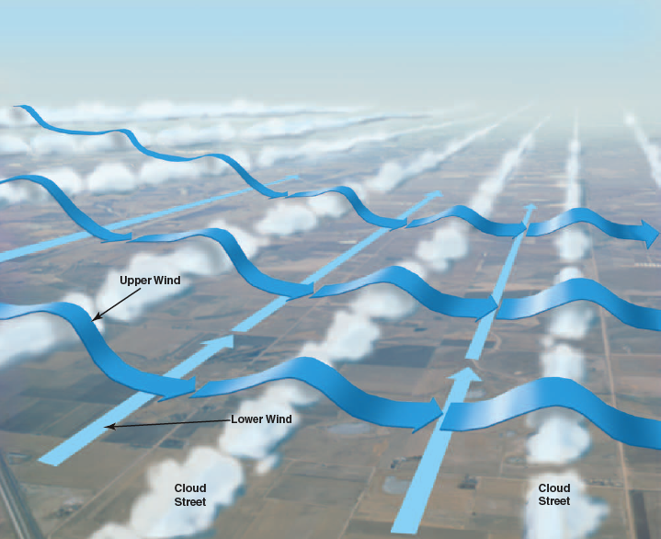
Cloudstreet Waves

Slide 25
Thermals
Require unstable airmass
  Negative thermal index
Cumulus clouds may form at the top
  Moisture content of air and maximum height
Streeting possible if wind permits
  Wind strength increasing with height to max at or below top of convection
  Wind direction relatively constant with height

Slide 26
Thunderstorms

Slide 27
Thunderstorms
Associated with cumulonimbus clouds
Should be avoided because of:
  Lightning and hail
  Severe winds and turbulence
  Microbursts and downbursts
  Lowered visibility in rain
  Possibility of squall lines

Slide 28
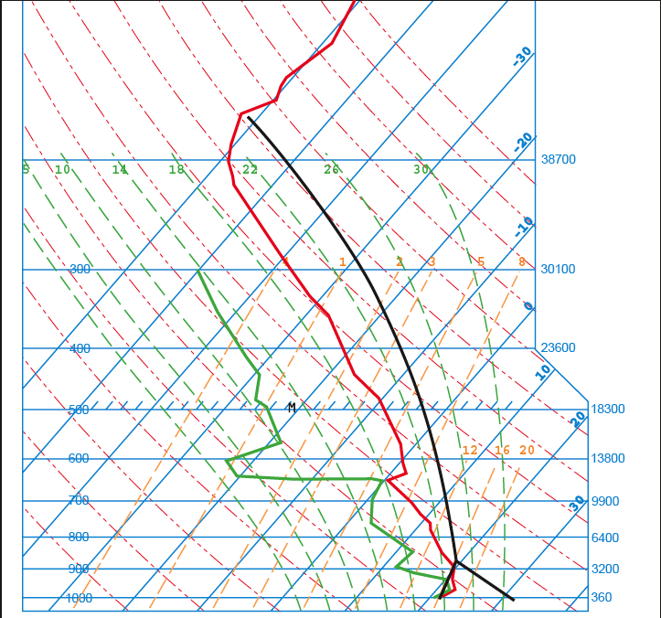
Thunderstorm Prediction

Slide 29
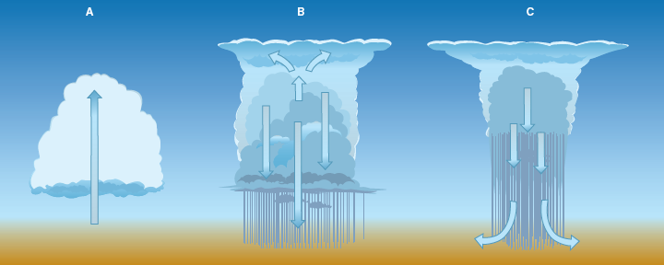
Life Cycle of a Thunderstorm
Cumulus
Mature
Dissipating

Slide 30
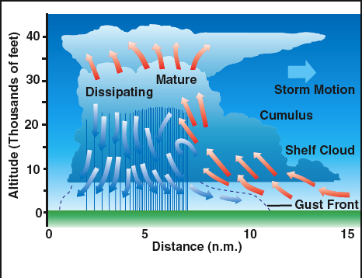
A Multi-Cell Thunderstorm

Slide 31
A Supercell Thunderstorm

Slide 32
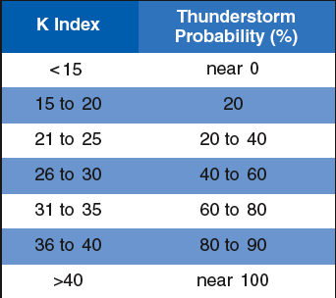
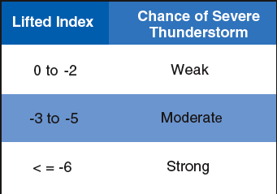
K and Lifted Indices

Slide 33
Sources of Weather Information

Slide 34
Obtaining Weather Data
Look outside!
Watch TV weather
Check wx.com
Call Flight Service Station (FSS)
Internet
  DUAT
  Aviation Digital Data Service (ADDS)
  Kevin Ford’s Thermal Forecast
  BLIPSPOT or BLIPMAP (Dr. Jack)
  NOAA Forecast Systems Laboratory (FSL)
  Many others!
Automated Weather Stations (AWOS/ASOS)
In-flight via aircraft radio

Slide 35
Aviation Weather Reports
Surface Observations (METAR)
Weather Depiction Charts
Surface Analysis Charts
Radar Summary Charts
Radar Reports
Pilot Reports
Satellite Imagery

Slide 36
Aviation Weather Forecasts
Terminal Forecasts (TAF)
Area Forecasts (FA)
Winds Aloft Forecasts (FD)
Surface Prog Charts
Airmets
Sigmets

Slide 37
Obtaining a Weather Briefing
Call FSS at 1-800-WX-BRIEF
  Identify yourself as a glider pilot
  Provide aircraft N number
  Give date, time, location and type of flight
  Ask for…
    Standard briefing
    Surface reports (METARs)
    Winds aloft forecast (FDs)
    Terminal forecasts (TAFs)
  Request other pertinent info
    NOTAMs and TFRs

Slide 38
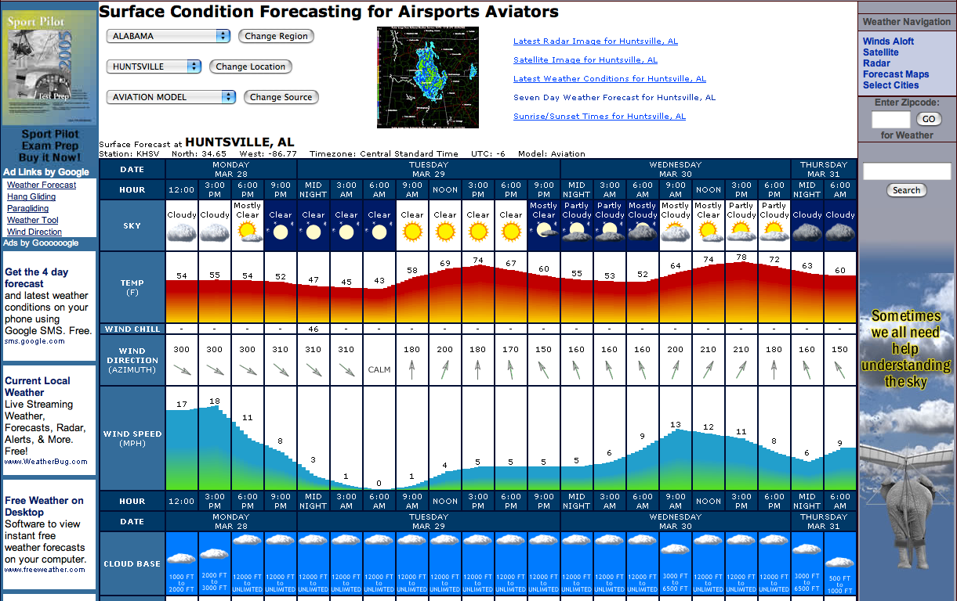
Air Sports Net
http://usairnet.com/cgi-bin/launch/code.cgi?sta=KHSV&model=avn&state=AL&Submit=Get+Forecast

Slide 39
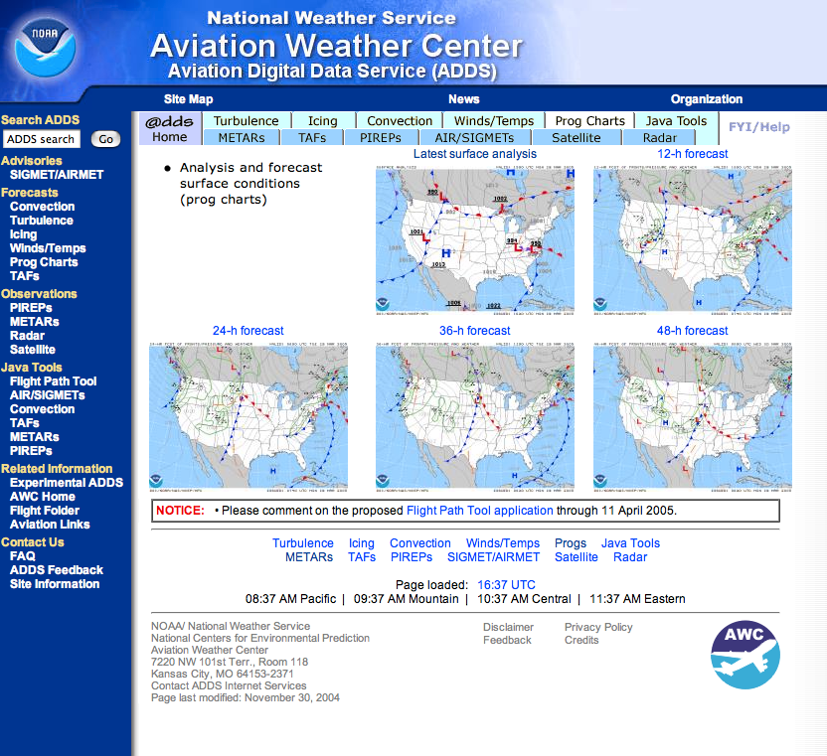
Aviation Digital Data Service
http://adds.aviationweather.gov/progs/

Slide 40
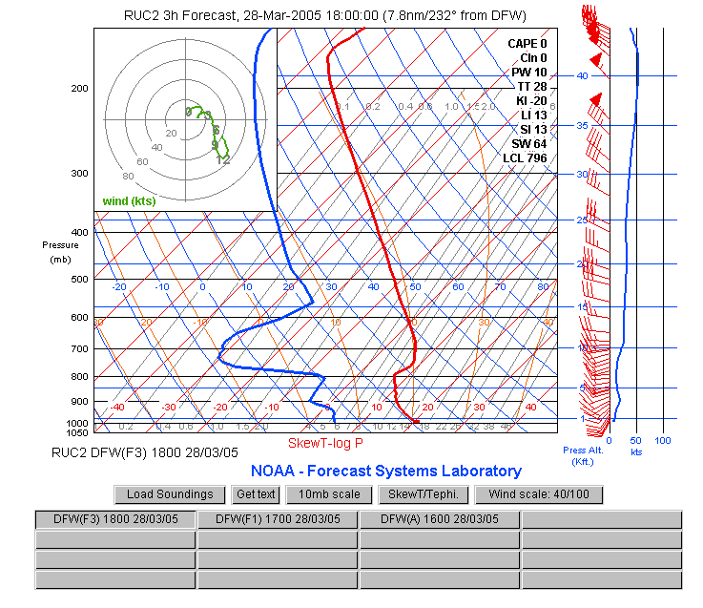
Forecast Soundings (FSL)
http://www-frd.fsl.noaa.gov/mab/soundings/java/

Slide 41
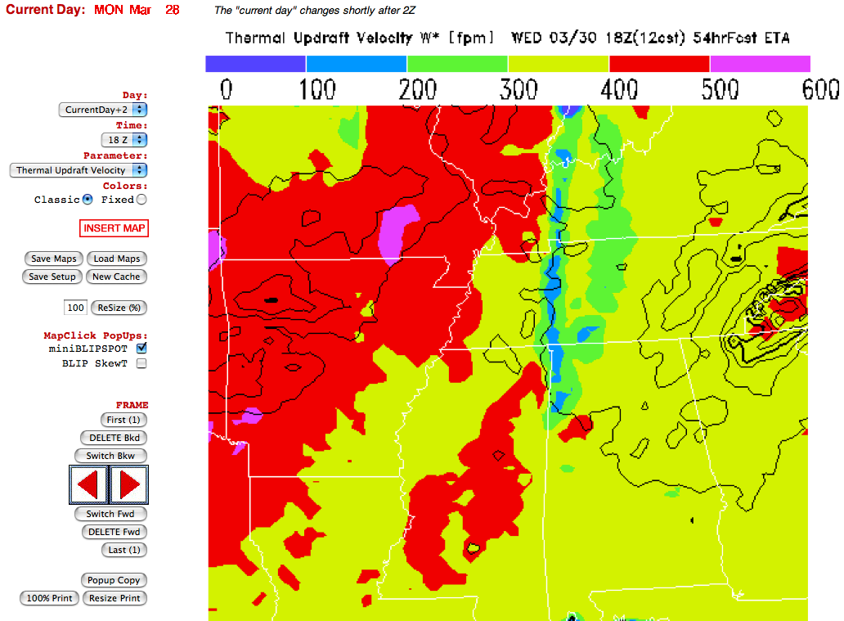
BLIPMAP
http://www.drjack.info/BLIP/index.html

